Slide 1
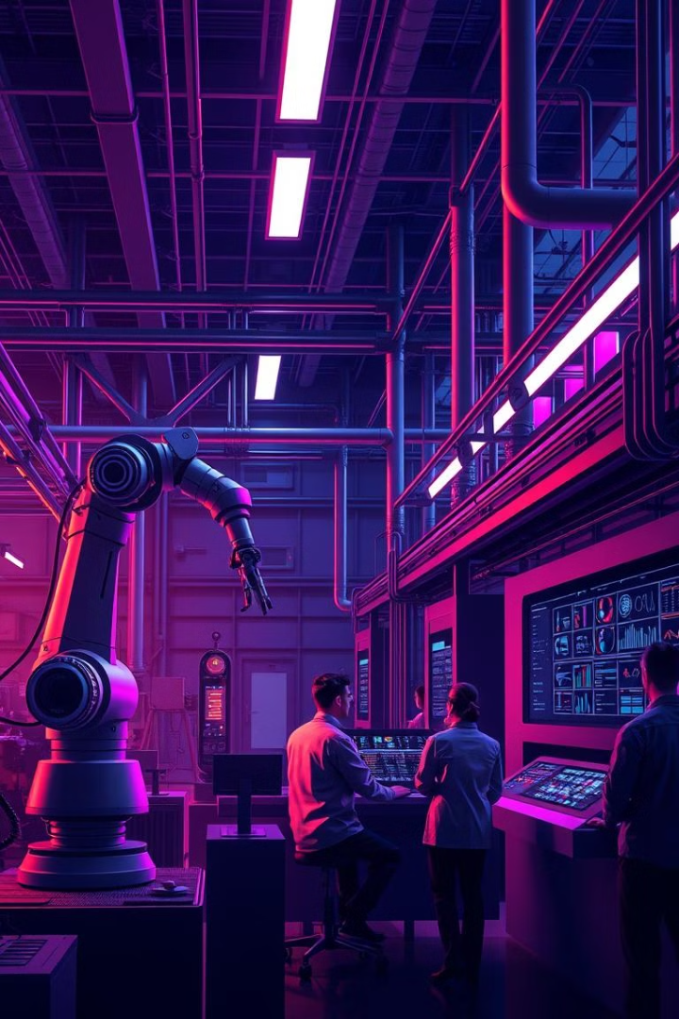
Streamlining Industrial Efficiency: A Comprehensive Management System
This presentation outlines a comprehensive industrial management system designed to optimize your factory's operations, employee management, machine maintenance, attendance tracking, and sales reporting. Leveraging AI-powered tools, this system empowers your organization to achieve greater efficiency, productivity, and profitability.
BSCS23070 - Muhammad Abdullah
BSCS23212 - Faizan Amir
BSCS23145 - Ibrahim Bin Ahmed

Slide 2
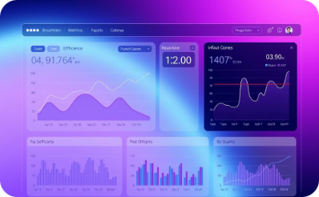
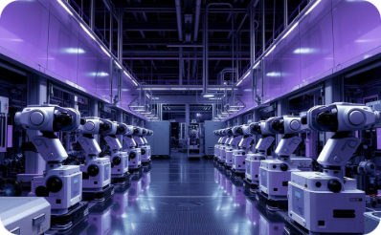
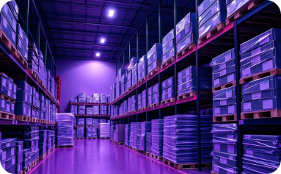

Streamline Factory Operations
Real-time Monitoring
Automated Scheduling
Inventory Management
System Integration
Production processes are monitored in real-time.
Scheduling and resource allocation are automated.
Inventory management and supply chain optimization are key.
Seamless data flow is achieved through system integration.

Slide 3

Optimize Employee Management
Performance Tracking
Skills Development
Monitor employee productivity and identify areas for improvement.
Provide tailored training programs to enhance employee skills.
Communication and Collaboration
Employee Feedback
Foster a culture of open communication and collaboration.
Gather feedback to enhance employee satisfaction and retention.

Slide 4
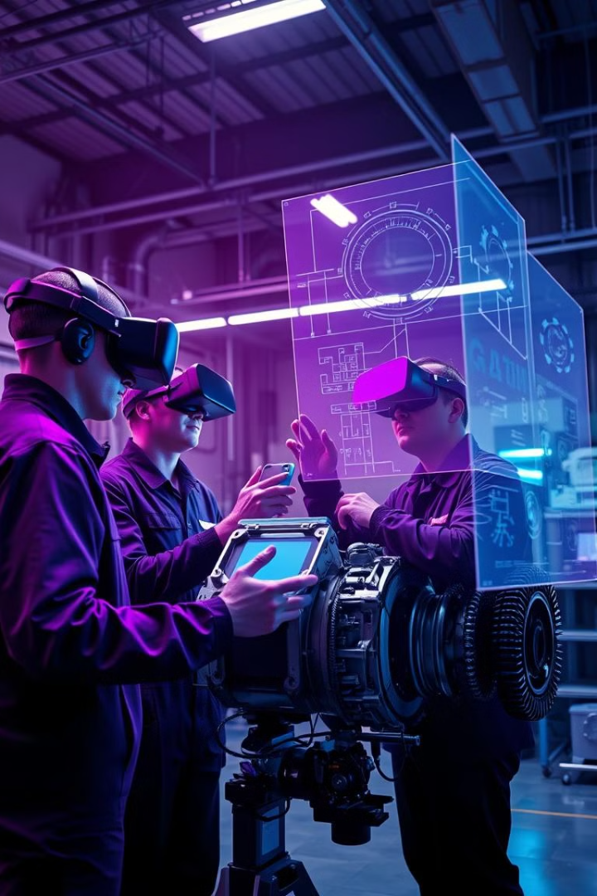


Intelligent Machine Maintenance
Ensure Timely Maintenance
Monitor Machine Status
Schedule proactive maintenance based on usage patterns and wear analysis.
Track real-time performance data to anticipate potential issues.
1
2
3
Log Maintenance Activities
Maintain a detailed record of all maintenance tasks and repairs.

Slide 5
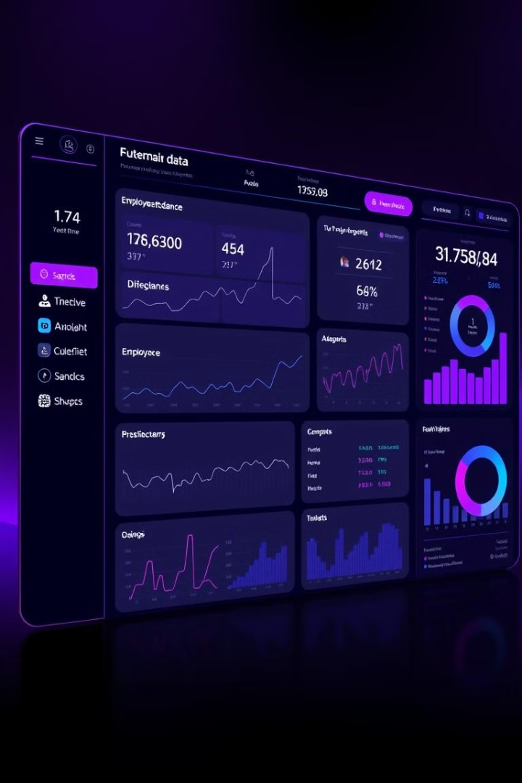
Attendance Tracking and Sales Reporting
1
Accurate attendance tracking.
2
Automated time and attendance reporting.
3
Real-time sales tracking and analysis.
4
Generate comprehensive sales reports.

Slide 6





System Architecture
Backend
Database
Authentication
Encryption
Node.js (Express framework)
MySQL
JWT with RSA encryption
AES encryption (CryptoJS)
Frontend
React

Slide 7
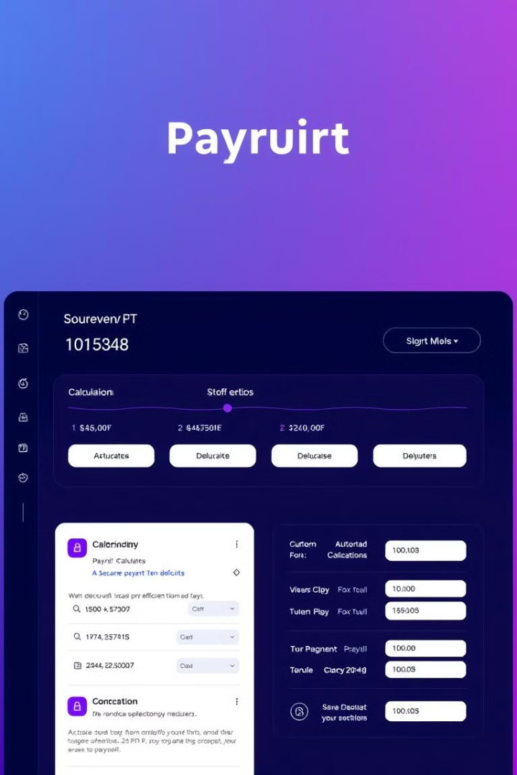
Payroll Management and Notifications
1
2
Automated Payroll Processing
Timely Payment Notifications
Reduce errors and save time.
Keep employees informed.
3
Payroll Compliance
Ensure legal and regulatory compliance.

Slide 8
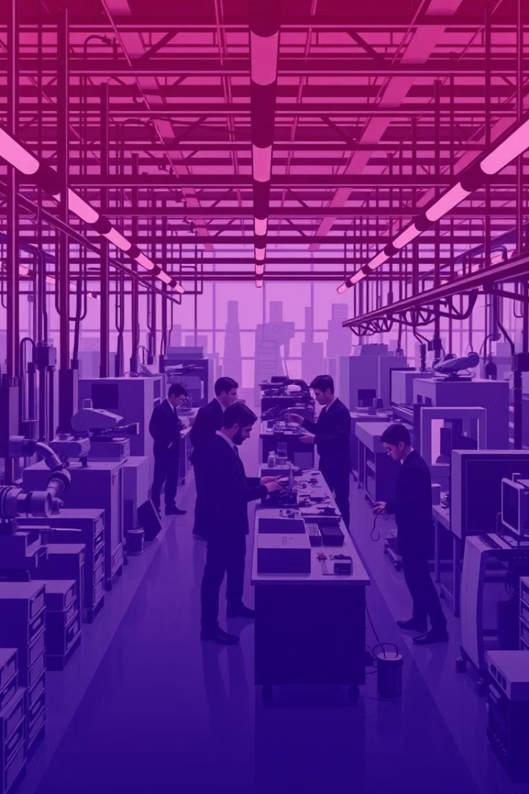
Ensuring Smooth Day-to-Day Operations
This comprehensive industrial management system empowers your organization to achieve greater efficiency, productivity, and profitability, streamlining operations, optimizing employee management, ensuring intelligent machine maintenance, and ensuring smooth day-to-day operations. By leveraging technology and AI-powered tools, you can elevate your factory's performance and embrace a future of progress and innovation.

Slide 9
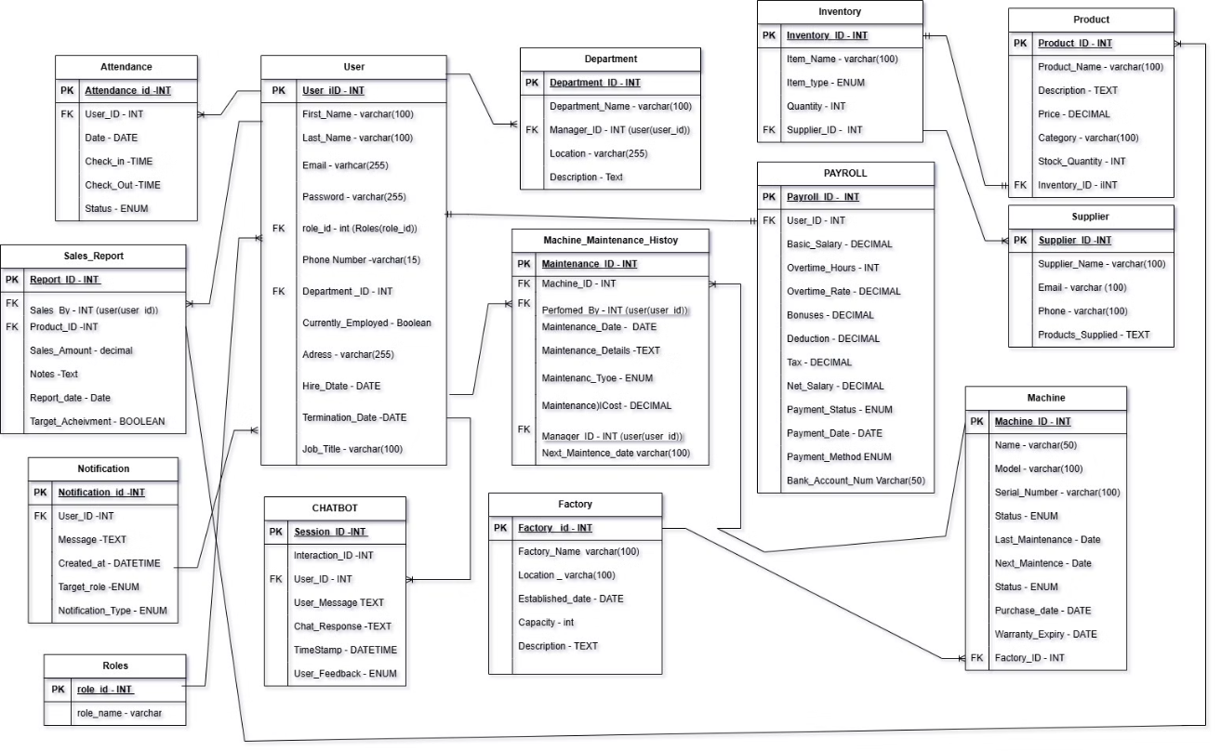
This slide displays the Entity-Relationship Diagram (ERD) for the project. The ERD visually represents the entities (tables) and their relationships within the database schema. This diagram is crucial for understanding the database structure and data relationships involved in the project.

